Slide 1
Delivering Value through DevSecOps: a Post-Incident Review
David Hawthorne
davidhawthorne.com | @shellninja
@shellninja
Notes:
This is a story about what happened when began to understand the dynamics of the business and the systems in organization

Slide 2

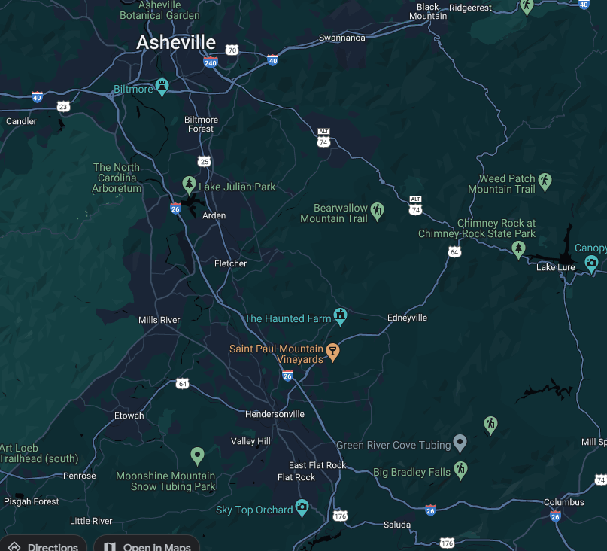





David Hawthorne
Director, Cloud Engineering O3 Solutions
Links: https://davidhawthorne.com
https://github.com/shellninja
Most platforms: @shellninja
Notes:
My name is DTH, links are up there.
I’m Dir, Cloud Engineering for O3 Solutions a Birmingham based company. In fact, I’ve been involved in Bham tech for over five years, it’s really a secret tech hub isn’t it?
I came here today from another secret tech hub, Western NC. The best small town in the world, between Hendo and Lake Lure.
You may not have heard of us, but you may have seen us on TV.

Slide 3












BY THE NUMBERS
10 SOLUTION AREAS
92% CLIENT SATISFACTION
10+ OWNERS
20,000+ USERS
550+
PROJECTS
50+
CONTRACTORS
18% PRODUCTIVITY IMPROVEMENT
10 WORK PACKAGE TYPES
10+ EPC FIRMS
58 NPS SCORE
1 COMPREHENSIVE
PLATFORM
Notes:
O3 is the market leading agile project management software built specifically to support Advanced Work Packaging (AWP) in capital construction projects. It’s the only solution on the market with true work package management. O3 Solutions helps Owner / Operators, EPC Firms, and Contractors building industrial capital assets transform the way they do business with agile methodologies and digital solutions.No matter the size of the project, from small-cap to mega projects, O3 is scalable and can support your AWP maturity journey. ​
O3 Solutions helps our clients learn how to effectively create, track, and manage work packages using our web-based software. Create 10+ types of work packages easily for projects of all types and sizes using our cloud-based platform. Establishing a successful Advanced Work Packaging (AWP) program is effective and straightforward when using the Power of O3.
Here’s a quick snapshot of O3 by the numbers. Some highlights include O3 being used on over 550 projects worldwide which includes Owners, EPCs and Contractors. Of those organizations there are over 20 thousand users managing over 10 types of work packages all on one single platform. And we have a very high NPS score as well as client satisfaction rate.

Slide 4

Security is a kitchen table issue
@shellninja
Notes:
This is a story about how you can build a ISMP on a low budget, make audits suck less, and improve how we communicate with/to/from security. This is the hardest thing I’ve ever done in my career, and I hope to make it easier for all of you no matter your domain of expertise, and some tools/tricks to take back home with you.
As developers we build Hello World, not Hello Secure World. That’s one reason I’m excited about projects like .NET Aspire that provide an opinionated cloud resource deployments – secure by default.
Everyone deserves security right? 50% have been in data breaches.

Slide 5
Lessons Learned
Treat the audit as an annual continuous improvement exercise
It takes about six months for a feature to be adopted. Expect a year before your security culture matures.
Align the Change Management procedures to your development process.
Pre-record videos of the tasks for walkthrough and share with audit team ahead of time this eliminates follow-up questions by addressing them from the pre-read rather than during the actual walkthrough.
Pin your IRP to your comm channels
Treat security tasks like bugs in grooming a sprint – top of the list.
Schedule ceremonies/required meetings at the next more frequent interval. For example, if it’s that Risk Committee meets quarterly as policy, meet monthly. People need to learn why they are there (see six-month rule).
Allow people the freedom to make mistakes, just because it’s resource that doesn’t meet policy doesn’t mean you have to enforce it like a cop.
Don’t ignore the business side of security – you’ve focused on your in-scope assets.
Responding to security questions in audit and for client questionnaires can be more art than science.
It’s the spirit of the control that’s important. While the ‘requirement’ may be to use X network tech, in reality the purpose is “isolation”… there are other paths, discuss with the audit team/compliance lead/vCISO
Once we began owning our infrastructure new insights and capabilities around Cost Optimization emerge.
Make a mirror at the start of the year for evidence requests based on the prior audit
After a major overhaul, reach out to your cyber-risk insurance and see if you can get a discount.
Put the policies in a retrieval augmented LLM because you aren’t going to remember them. Use it for security questionnaires and quick lookups, better if citations are present.
Automated compliance or any other tooling is going to miss, a lot. No one ever said, run npm audit or clamav in the pipeline. No one ever said, secure the App Service’s internal SCM site. Use other tools.
@shellninja
Notes:
We have a ton of lessons learned, but if you follow blameless – it’s not the why but the how that’s important.
Don’t worry, I’ll dig into this wall of text soon for now let’s check in on what went well and what did not

Slide 6

Notes:
I had seen security done right, seen it done bad. But I’m no CISSP, or other certification… I’m a factotum with a little industry experience working in compliance environments. And often security felt like vogon slap sticks every time I needed to do anything.

Slide 7
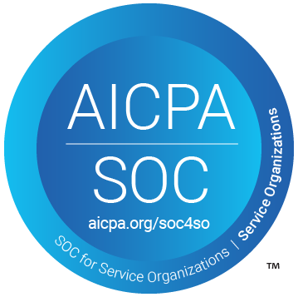
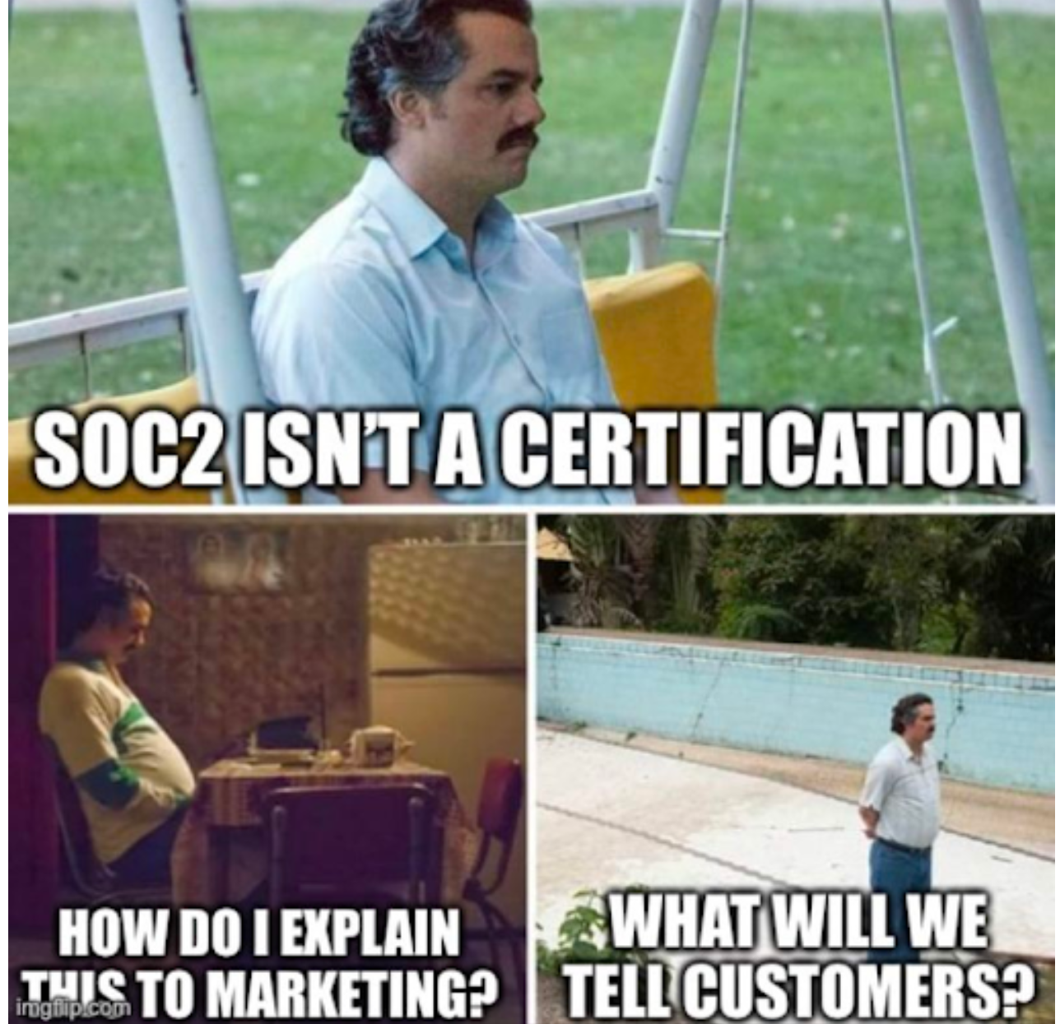
Incident: Achieve SOC 2 Compliance in under 90 days
Compliance Framework
Security
Availability
Processing Integrity
Confidentiality
Privacy
@shellninja
Notes:
SOC 2 compliance is a framework that ensures organizations securely manage and protect customer data by adhering to rigorous controls based on trust service principles like security, availability, processing integrity, confidentiality, and privacy.

Slide 8



Where we started: Strong DevOps culture Lean, Agile Scrum – Done Right Full CI/CD with TESTS Fully integrated operational data store Do more with less
@shellninja
Notes:
No scrumfall, Bugs go into the top of the sprint and knocked out first
We've fully integrated an operational data store that seamlessly connects with every system across our business, ensuring comprehensive and unified access to all critical data.
Being Lean/Agile haD made us successful
In a team with high-trust, this incredible environment works against you
We’re putting in barriers, without established value
Need to clear self openers
Sometimes there’s only two eyes to do merge.

Slide 9
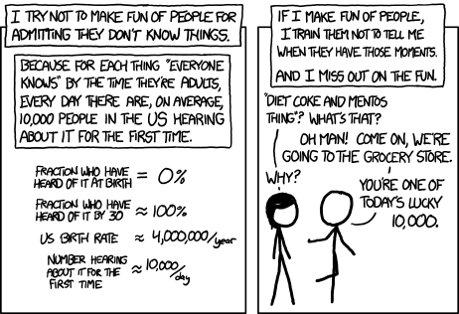
Saying 'what kind of an idiot doesn't know about the Yellowstone supervolcano' is so much more boring than telling someone about the Yellowstone supervolcano for the first time.
https://xkcd.com/1053
@shellninja
Notes:
Someone had to own SOC 2 and I’d been a developer, sys admin, data and software architect roles so I spoke the language. How do you build a CoE when you’re something that doesn’t scale.
One of the greatest challenges we faced was introducing new concepts, and instead of locking everything down (although we did) eventually I realized we needed a different approach.

Slide 10


How do you make a CoE of 1?
https://commons.wikimedia.org/wiki/File:Police_blockade_during_January_16_events.jpg
https://commons.wikimedia.org/wiki/File:Lifeguard_jumping_into_action,_Ocean_City,_June_27_,2007.jpg
@shellninja
https://tenor.com/view/gif-gif-24673481
Notes:
Say “the auditors will ask for X, if we do this it will cause an exception”
Call out Marcel on this one

Slide 11

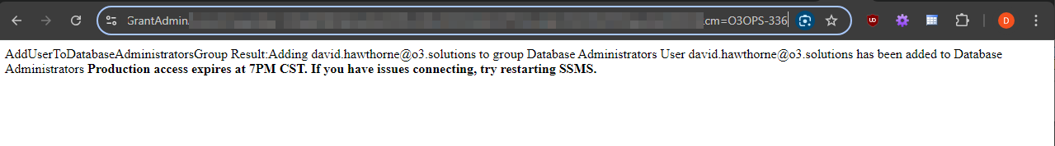
You need to make CM for that!
@shellninja
Notes:
Evidence requests are tests after all, eh? We already do a ton of TDD, what if we treated our evidence requests as unit tests?

Slide 12
Three years later:
Sustainable security program & strong DevSecOps culture
The business is aligned with SOC
Doubled the size of the team
@shellninja
Notes:
How do you build a CoE when you’re something that doesn’t scale

Slide 13

SOC 2
What went well
What didn’t go Well
Rethinking instead of remediating
Audit ready in 1 month, took 90 days.
Rapid IaC development
Expanded analytics
Impression of automated compliance
In a team with a lot of trust, sometimes it can be hard to introduce new language.
Aligning the SOC program with the business
@shellninja
Notes:
It takes ~6 months for a feature to become adopted. It takes a year to hit steady state.

Slide 14
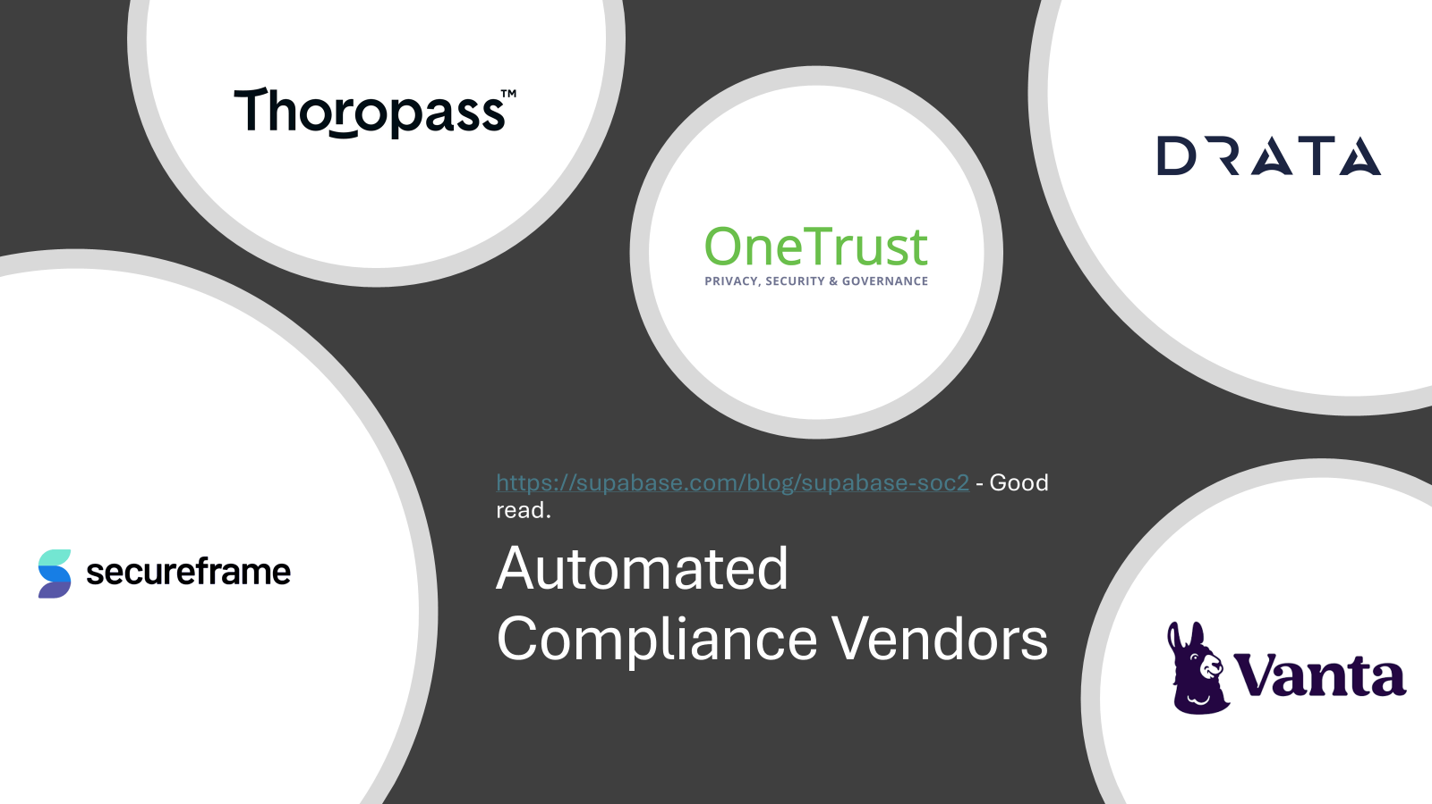

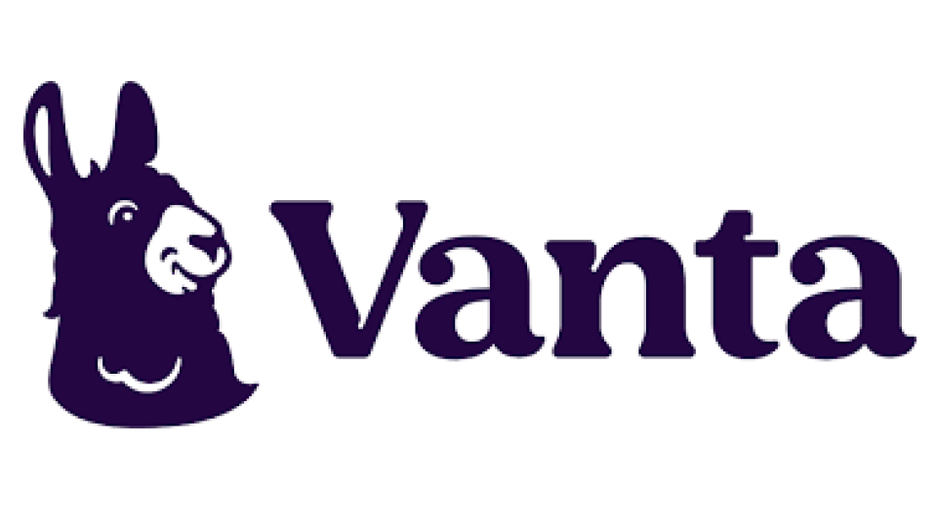


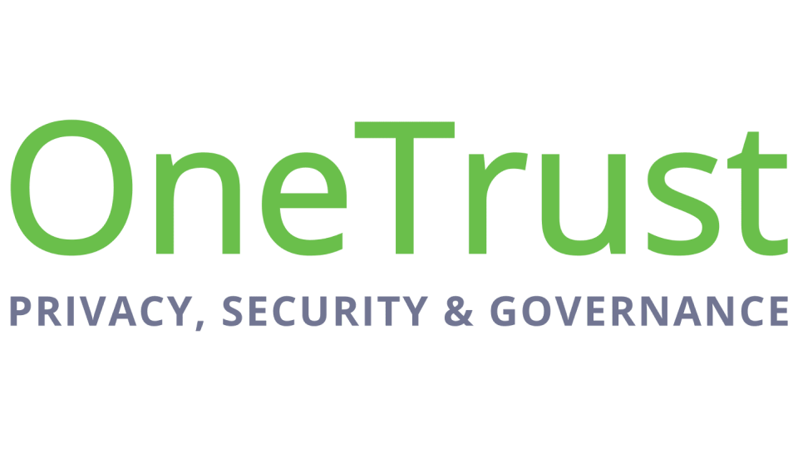
Automated Compliance Vendors
https://supabase.com/blog/supabase-soc2 - Good read.
Notes:
Chose a vendor with an alpha product

Slide 15
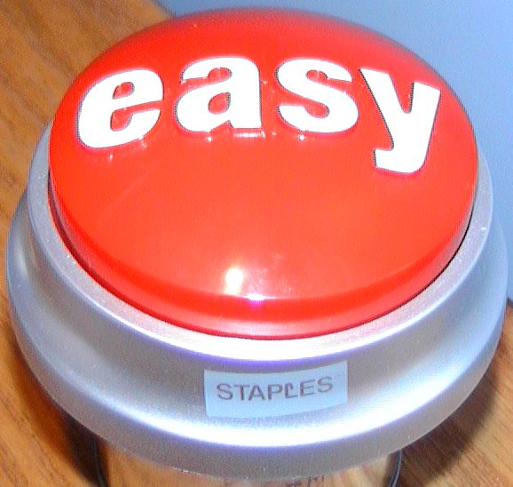
Automated Compliance:
Audit ready in two weeks
Integrate your systems
Expenses
@shellninja
Notes:
Easy buttons keep time linear
Allow me to stay in flow
Shape our focus
Speaking of Expenses I did the only thing a tech worker could do when attempting to explain something that is larger under the surface… an iceberg.
Glorified To-do list
A few steampipe queries “select * from cloud?”
But there’s hope
The “compliance architects” can be helpful in ensuring prep, and then
If you do everything in there, you’d easily have $100k overnight
You don’t have to, but if your provider is AWS and you’re in Azure… good luck
Not recognized by CSA so we’re looking at PwC

Slide 16
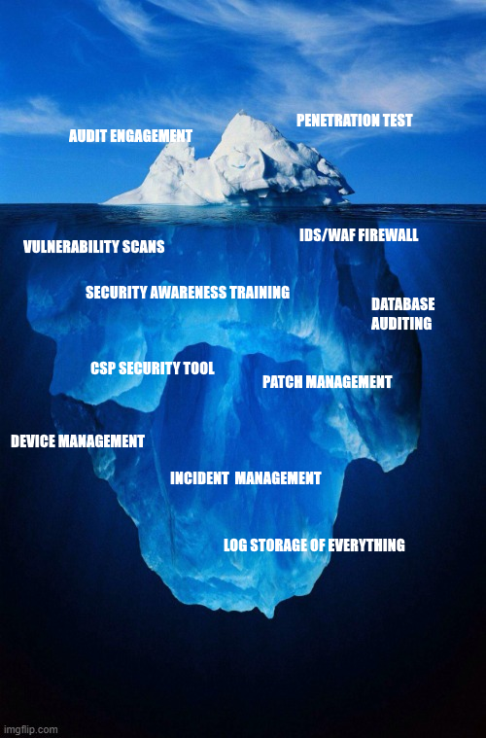
$10k-40k Estimated
Pentest
Vulnerability Scans*
IDS/Firewall
Database Auditing
Log Storage & Retention
Security Awareness Training*
Device Management and Patching*
https://davidhawthorne.com
Notes:
Asterisk are optional, but recommended.

Slide 17
RETHINK
the need
Collaborative Inclusion
Org-Wide adoption
Share
@shellninja
Notes:
Strategic
Cost Effective
People are excited
Hey HR, we have an LMS now – think you can use that for training on lawful hiring?

Slide 18
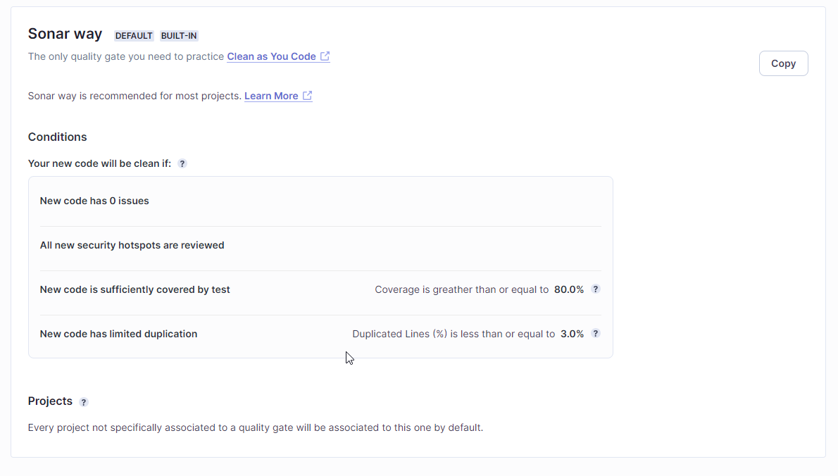

What if a tool could do more? Test your code for vulnerabilities . Scale the team by creating quality gates.
https://www.sonarsource.com/products/sonarqube/
@shellninja

Slide 19
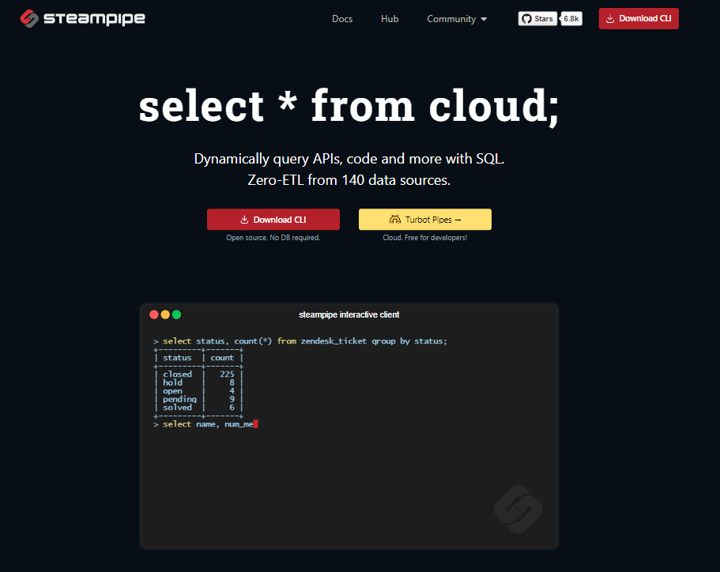
Steampipe
Query ANYTHING.
Spin up a container instance in a few lines, warehouse the data, shorten the loop.
@shellninja
Notes:
For example, the compliance solution says all keys should have an expiration date – but don’t give the specific key name, etc.

Slide 20
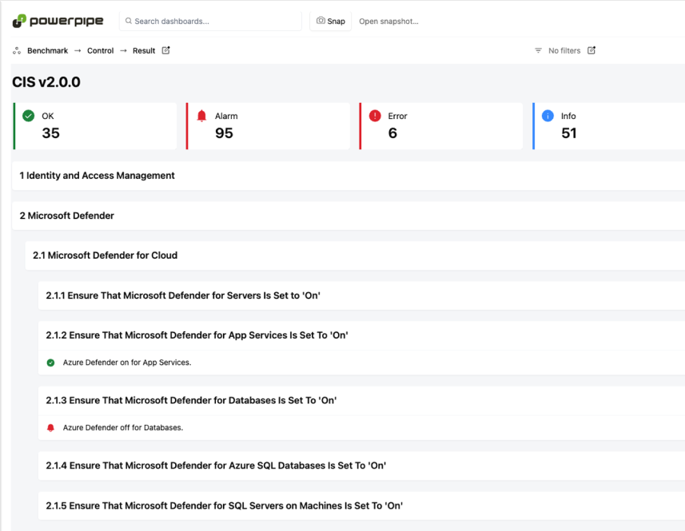
Dashboards
https://steampipe.io
CIS, HIPAA HITRUST, PCI-DSS, NIST SP 800-171, and more
Not limited to cloud resources – Entra, 1Password, Jira, Keycloak, Kubernetes, and more: Plugin Directory
All the stuff
@shellninja
Notes:
If you are considering going towards compliance, this will give you an idea of where you stand.
No matter where you are in your journey, Steampipe has a module for just about any enterprise system.

Slide 21

@shellninja

Slide 22
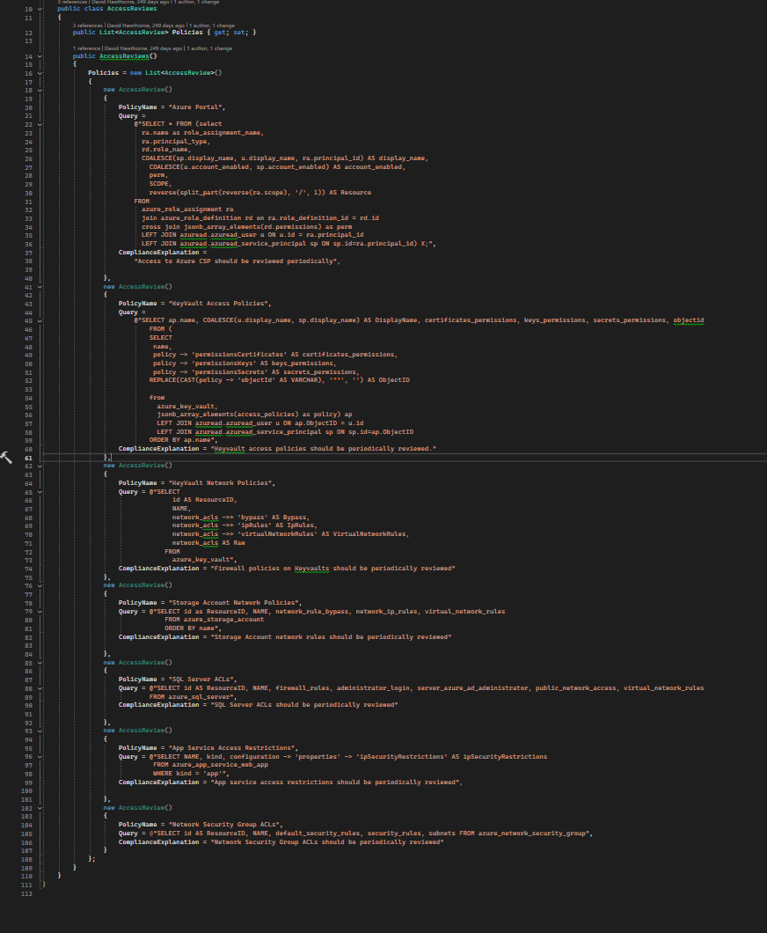
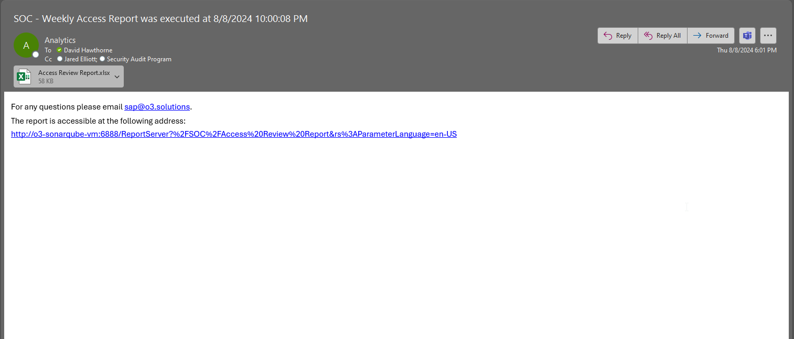
RETHINK – Access Reviews
Throw it in Excel with a few CONCAT()s and voila
I can get a delta report now!
@shellninja

Slide 23
https://github.com/prowler-cloud/prowler: Prowler is an Open Source security tool to perform AWS, Azure, Google Cloud and Kubernetes security best practices assessments, audits, incident response, continuous monitoring, hardening and forensics readiness, and also remediations!
https://wazuh.com: Unified XDR and SIEM protection for endpoints
and cloud workloads.
https://www.pfsense.org: The pfSense project is a free network firewall distribution, based on the FreeBSD operating system with a custom kernel and including third party free software packages for additional functionality. pfSense software, with the help of the package system, is able to provide the same functionality or more of common commercial firewalls.
@shellninja
Notes:
Sorry, I’m a data guy – VLOOKUP(MATCH(CONCAT))) IS MY JAM.

Slide 24
Sometimes it’s the tools you already have
When was the last time you ran audit in your package manager
Why isn’t that part of the branch build?
When was the last time you audited your licenses?
CLI tools are out there!

Slide 25
Evidence Requests
@shellninja
Notes:
Remember, easy buttons keep time linear

Slide 26
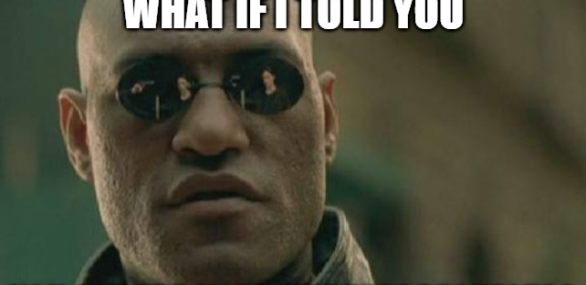
RETHINK
There’s an easy button?
@shellninja
Notes:
Don’t repeat yourself

Slide 27
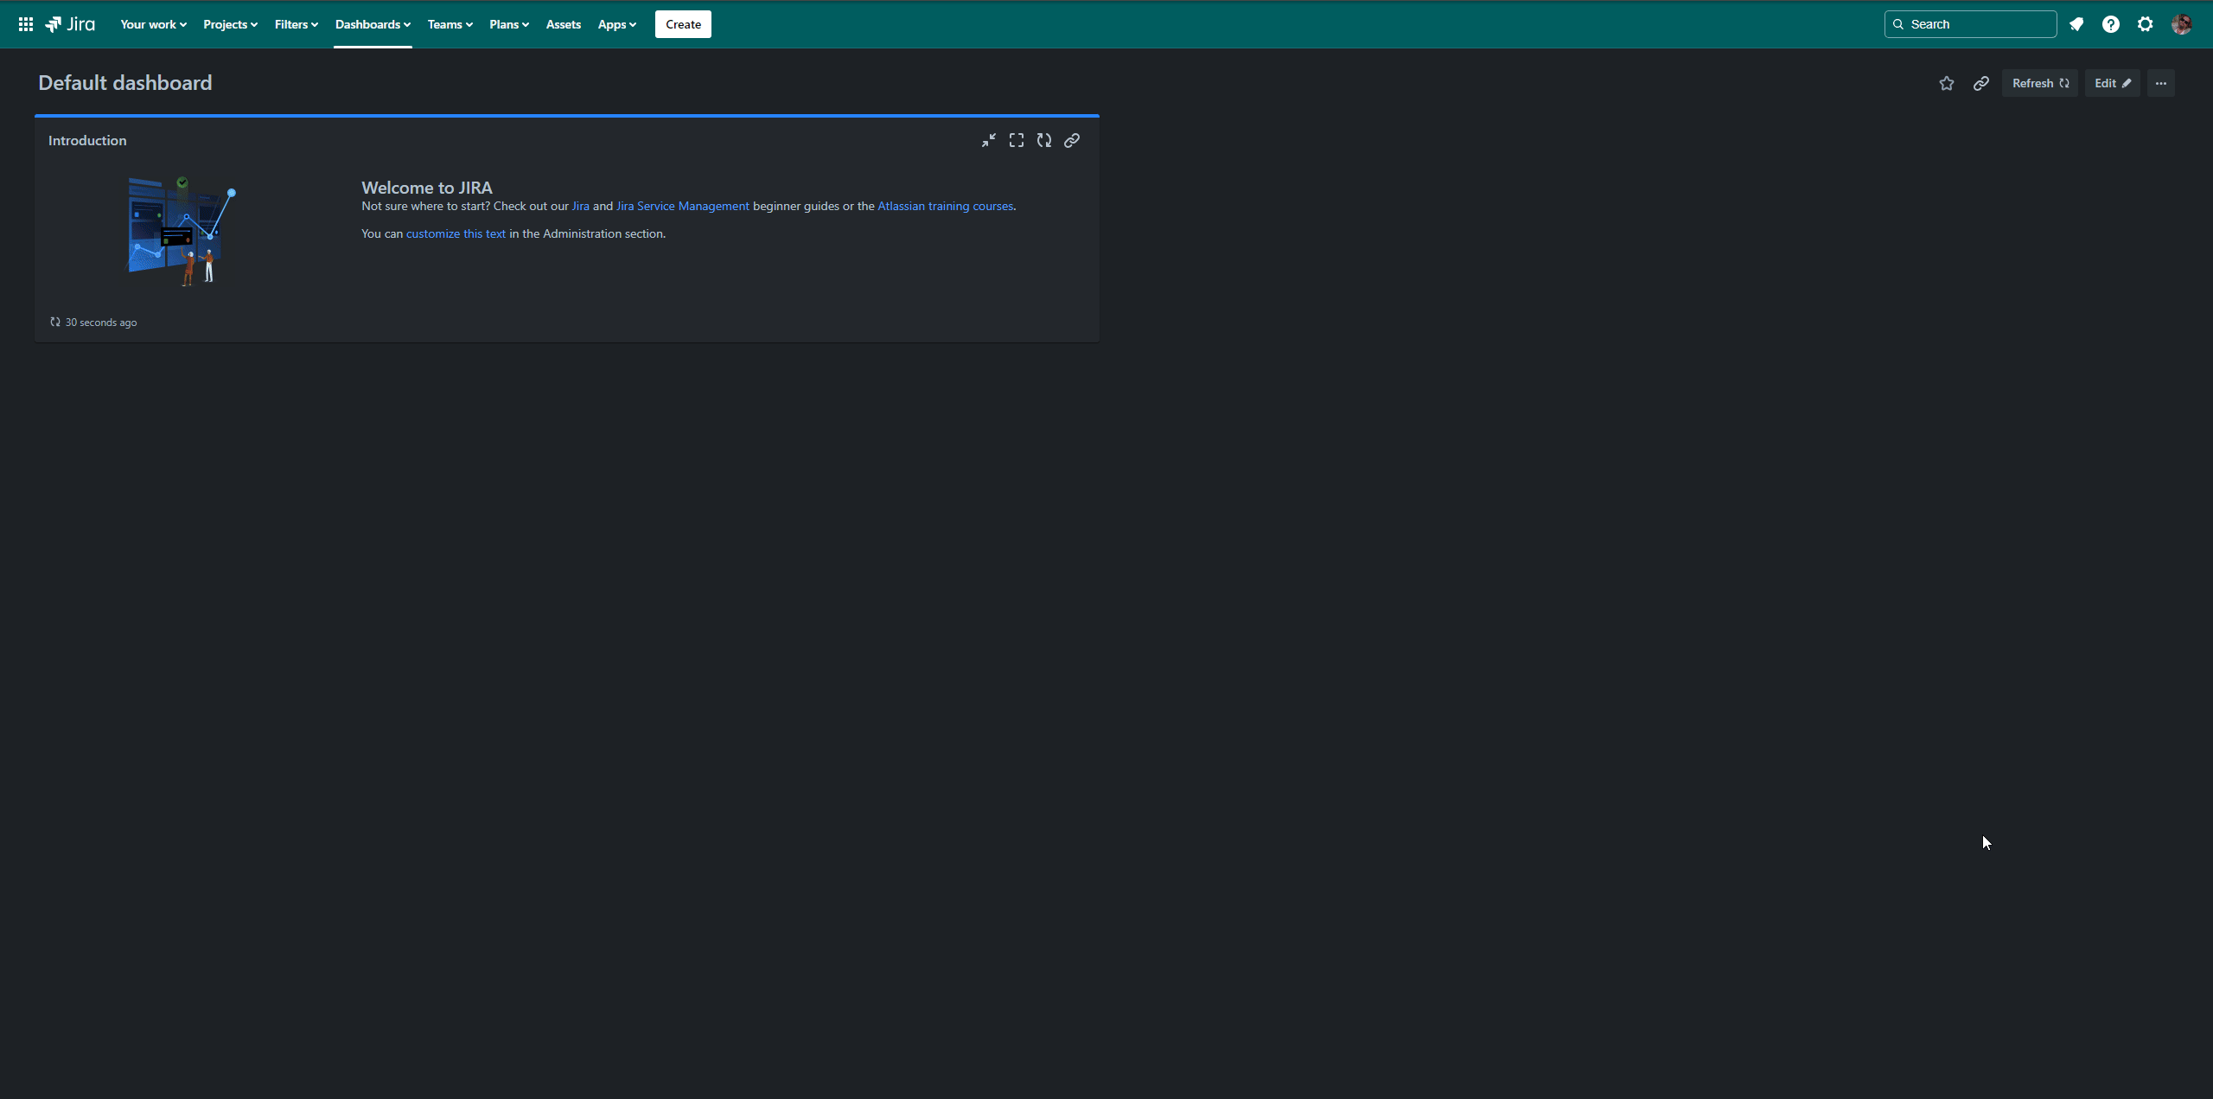
Evidence Requests are Tests
@shellninja
Notes:
Evidence requests are tests after all, eh? We already do a ton of TDD, what if we treated our evidence requests as unit tests?

Slide 28
Lessons Learned
Lifeguards NOT police
Treat the audit as an annual continuous improvement exercise. Once it ends, create a data room based on that audit for the next year.
It takes about six months for a feature to be adopted. Expect a year before your security culture matures.
Align the Change Management procedures to your development process.
Pre-record videos of the tasks for walkthrough and share with audit team ahead of time this eliminates follow-up questions by addressing them from the pre-read rather than during the actual walkthrough.
Pin your IRP to your comm channels
Treat security tasks like bugs in grooming a sprint – top of the list.
Schedule ceremonies/required meetings at the next more frequent interval. For example, if it’s that Risk Committee meets quarterly as policy, meet monthly. People need to learn why they are there (see six month rule).
Allow people the freedom to make mistakes, just because it’s resource that doesn’t meet policy doesn’t mean you have to enforce it like a cop.
Don’t ignore the business side of security – you’ve focused on your in-scope assets up to this point and you’ll get blindsided with an incident if left out of the InfoSec program.
Responding to security questions in audit and for client questionnaires can be more art than science.
It’s the spirit of the control that’s important. While the ‘requirement’ may be to use X network tech, in reality the purpose is “isolation”… there are other paths, discuss with the audit team/compliance lead/vCISO
Once we began owning our infrastructure new insights and capabilities around Cost Optimization emerge.
Make a mirror at the start of the year for evidence requests based on the prior audit
After a major overhaul, reach out to your cyber-risk insurance and see if you can get a discount.
Put the policies in a retrieval augmented LLM because you aren’t going to remember them. Use it for security questionnaires and quick lookups, better if citations are present.
Automated compliance or any other tooling is going to miss, a lot. No one ever said, run npm audit or clamav in the pipeline. No one ever said, secure the App Service’s internal SCM site. Use other tools.
@shellninja
Notes:
We have a ton of lessons learned, but if you follow blameless – it’s not the why but the how that’s important.
Don’t worry, I’ll dig into this wall of text soon for now let’s check in on what went well and what did not

Slide 29
For more information:
Slides and Sample Code https://github.com/shellninja/DevOpsDaysBham2024
Get in Touch
https://davidhawthorne.com
Most Platforms
@shellninja

